Slide 1
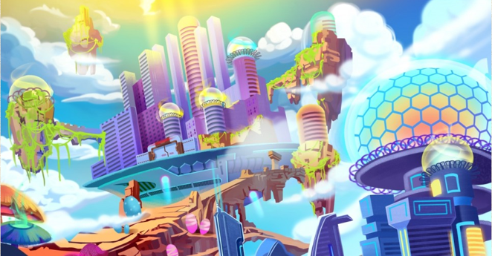

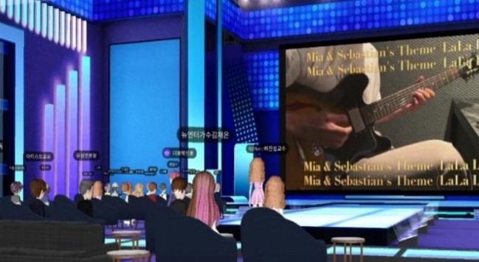
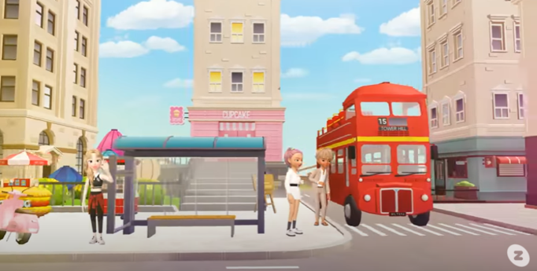
Metaverse
Festival
It is a compound word of "meta" meaning abstract and "Universe" meaning real world, meaning 3D virtual world.
Purpose
To experience a free and endless festival in a world without the virus of COVID19.
Date & time
Ex ) 2021 . 12 . 01 all day!
Entrance Fee
$ 5
Program
Everything you want, including performances, movie festivals, fireworks, food and beer festivals!

Slide 2
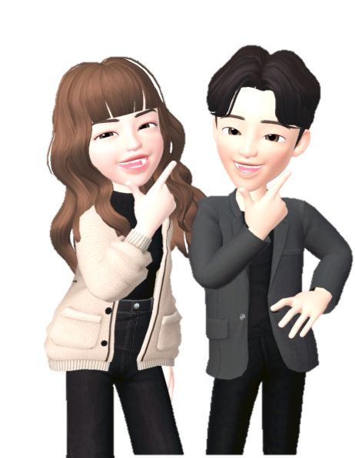




I
ANHA UNIVERSITY
FESTIVAL
2021
with METAVERSE
Inha Universityㅇ
Festival
Metaverse
It is a compound word of "meta" meaning abstract and "Universe" meaning real world, meaning 3D virtual world.
PURPOSE
What Is
We would like to hold a festival where you can communicate and enjoy even in a non-face-to-face environment through a metaverse.
Abstract Real World
“META”+”UNIVERSE”
= 3D Virtual World
DATE&TIME
5TH NOV
AM 8 – PM 10
PROGRAM
School Club Booth Parade
Karaoke in metaverse
Explore ghost house
Take a picture with sculpture
Fireworks
PLACE
Inha University Map on Naver Zepeto
※ Our festival implements the COVID-19 quarantine rules.

Slide 3
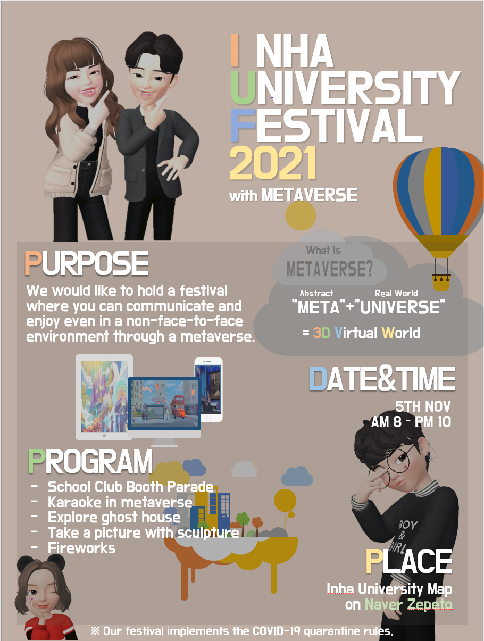

Slide 4
